Slide 1

BRITISH AIRWAYS
CUSTOMER’S PREDICTIVE MODELLING
01/12/2024

Slide 2
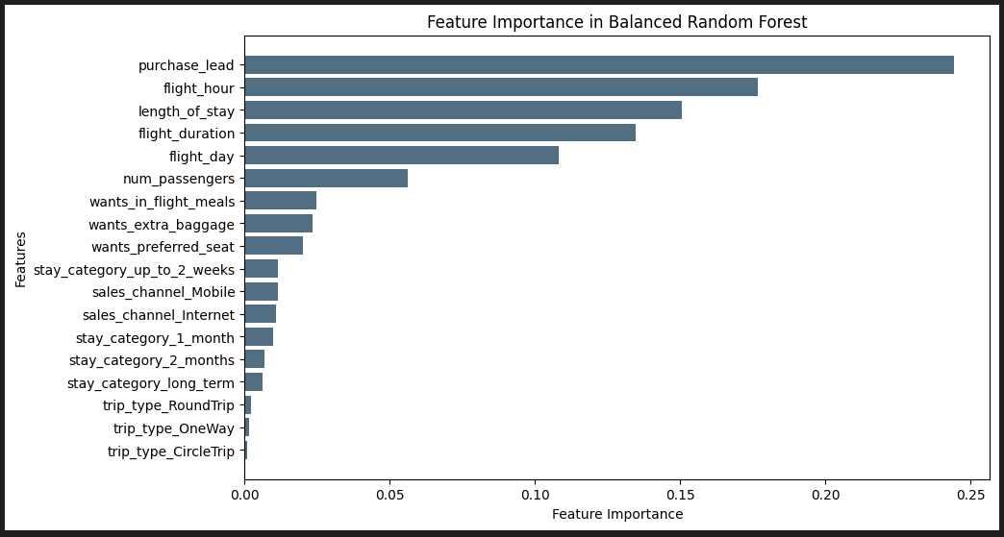
PREDICTIVE MODELLING
Accuracy
62%
Precision
61%
Recall
60%
Indicates overall correct predictions.
Indicates the percentage of true successful bookings correctly predicted
Measures the model’s ability to find all actual successful bookings.
Class Imbalance Addressed: The dataset initially had a severe imbalance, skewed towards incomplete bookings.
Balancing techniques (down-sampling and SMOTE) were applied, resulting in a dataset with 8,000 incomplete and 7,000 complete bookings.
Balancing ensured fair and unbiased model predictions
Cross-Validation Results
Cross-validation was conducted with a mean F1-score of 61%.
Confirms that the model performs consistently across different data splits.
F1-Score
60%
Purchase Lead, Flight Hour, and Length of Stay are the most influential predictors of booking completion. These features play a crucial role in the model's ability to forecast whether a customer will finalize a booking. By understanding these factors, strategies can be tailored to target key customer behaviors, ultimately enhancing booking rates and overall customer engagement.
Fig: Key Features Influencing Booking Completion

